Slide 1
Demo on Xpaths
Saurabh Kandhway

Slide 2

About Me
My name is Saurabh Kandhway . I have around 10+ years of Experience into QA Automation role . I am currently working as a Test Architect in one of the Leading MNCs .I have around 5+ years of teaching experience into all the tools and technologies used for testing .I have also worked as Onsite test analyst for 2 years in Melbourne Australia .I am ISTQB , AZ 900 Microsoft Azure Fundamentals, Pcloudy (Cloud based environment for Testing) certified testing professional . I am a certified Simplilearn high Engagement trainer.

Slide 3
What are Locators in Selenium
Locators in Selenium WebDriver provide mechanisms for identifying HTML elements on the page. Selenium supports a number of different web locators, and you have to choose the one that meets your test requirements.
Types of Locators in Selenium
ID
Name
ClassName
LinkText
Partial Link text
TagName
CssSelector
Xpath

Slide 4
What are Xpaths
XPath is a technique in Selenium to navigate through the HTML structure of a page. XPath enables testers to navigate through the XML structure of any document, and this can be used on both HTML and XML documents.
Types of Xpath
Absolute Xpath- The absolute xpath has the complete path beginning from the root to the element which we want to identify. An absolute xpath starts with the / symbol. One drawback with the absolute xpath is that if there is any change in attributes beginning from the root to the element, our absolute xpath will become invalid Eg-/html//div/div/div/div[1]/div/a/img
Relative Xpath -Relative Xpath starts from the middle of HTML DOM structure. It starts with double forward slash (//). It can search elements anywhere on the webpage, means no need to write a long xpath and you can start from the middle of HTML DOM structure

Slide 5
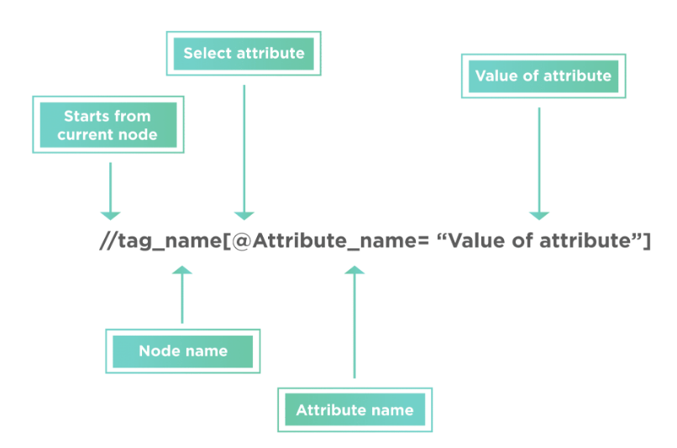
Syntax of Xpath
XPath finds any element within a webpage by using DOM. So, its syntax is also made up of DOM attributes and tags, as shown below:
XPath = //tag_name[@Attribute_name = “Value of attribute”]

Slide 6
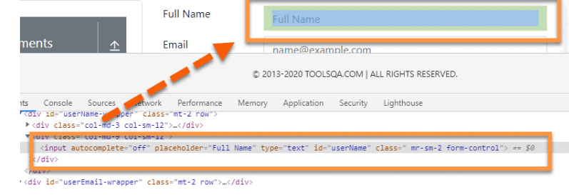
Xpath Contains Function
XPath Contains() is one of the methods used while creating an XPath expression. We can use it if part of the value of any attribute changes dynamically. It can identify any attribute by using its partial value. The syntax for using the XPath contains() method is:
//tag_name[contains(@attribute,'value_of_attribute’)]
where the contains() method accepts two parameters:
The attribute of the tag which needs to validate for locating the web element.
The Partial value of the attribute, which the attribute should contain.
Xpath will be following ,
//input[contains(@id, "userN")]

Slide 7
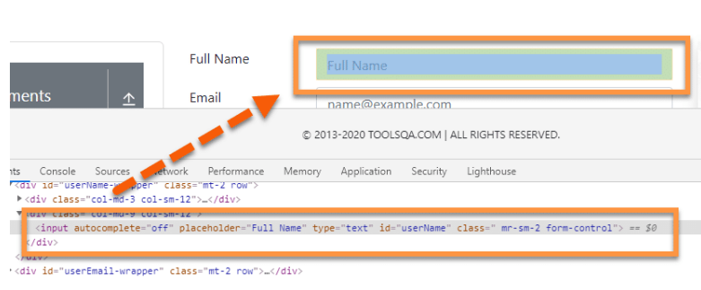
XPath Starts-with() function
The XPath starts-with() function, as the name suggests, finds the element which has attribute value starting with the specific given character or character sequence.
This function is quite useful while dealing with dynamic web pages.
Syntax of the starts-with() method for XPath is:
//tag_name[starts-with(@attribute,'Part_of_Attribute_value’)]
The Xpath for this DOM structure with “Starts-with()
Function is”
//input[starts-with(@placeholder,"Fu")]

Slide 8
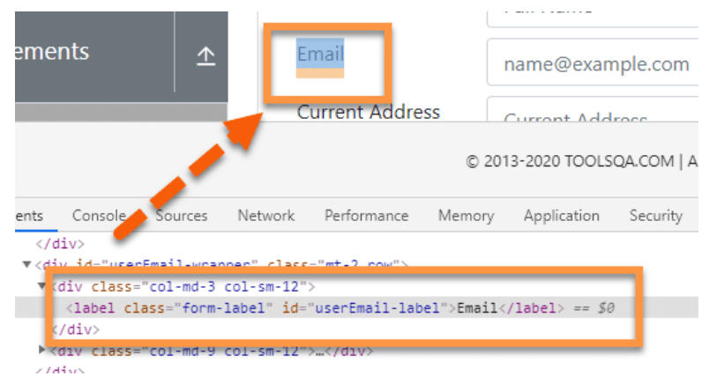
XPath Text() function
This function uses the text of the web element for locating the element on the webpage. This function is quite useful if your element contains the text, for example, labels, which always contain a static text.
The syntax of the text() function in XPath is:
//tag_name[text()='Text of the element’]
The Dom structure of element is ,
<label class="form-label" id="userEmail-label">Email</label>
The Xpath will be ,
//label[text()=”Email”]

Slide 9
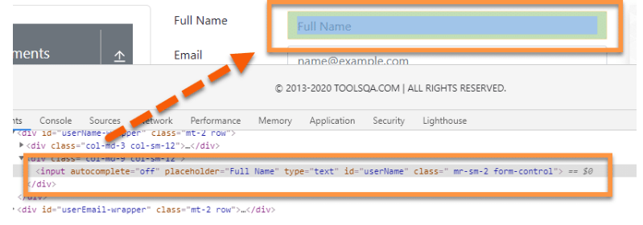
Xpath – AND & OR Operators
The "and " operator is used to combining two different conditions or attributes to identify any element from a webpage using XPath efficiently.
The "or " operator is used to locate an element based on any of the conditions segregated by the "or " operator
For example, if we have two attributes, a and b, we can combine both to uniquely identify an element on the webpage using the "and " operator.
The syntax for using the “and ” operator is:
//tag_name[@name = 'Name value' and @id = ‘ID value’]
The syntax for using the “or ” operator is:
//tag_name[@name = 'Name value' or @id = ‘ID value’]
So, if any one of the conditions is true, the XPath will locate the element successfully.

Slide 10
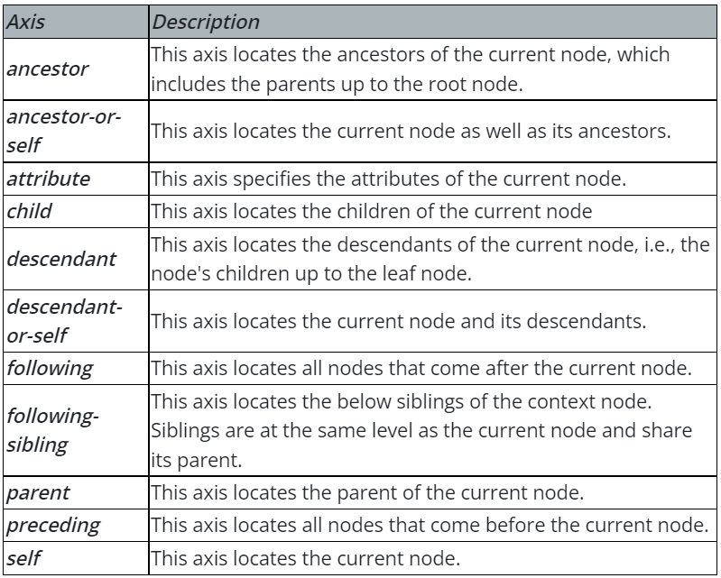
Xpath Axes
All the web elements in the XML DOM are related to each other via a hierarchical structure. XPath provides specific attributes that are called "XPath Axis", and these use the relationship between various nodes to locate those nodes in the DOM structure. The following table shows a few of those Axis, which can locate the elements on a web page using XPath in Selenium.

